Slide 1

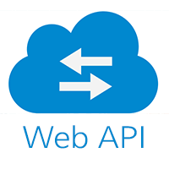
JSON and Web APIs
Applications in Python
- with Christian Wilson

Slide 2
Overview
Motivation
What’s an API?
What’s a Web API?
Web APIs
Overview
Step Back: What is HTTP?
Difference Between the Web and a Web API
Why Should We Care?
What’s in a Web API? – Parameters and Endpoints
Web API Applications
JSON
Addendum
Practice!

Slide 3
What’s an API?
API stands for “Application Programming Interface”
Anything that interacts with a computer in a programmatic fashion is an API
Generally, APIs allow computers to interface/“talk” to one another
Use cases:
Getting data from a database
Getting the most recent score of cricket match
Creating an invoice for your client

Slide 4
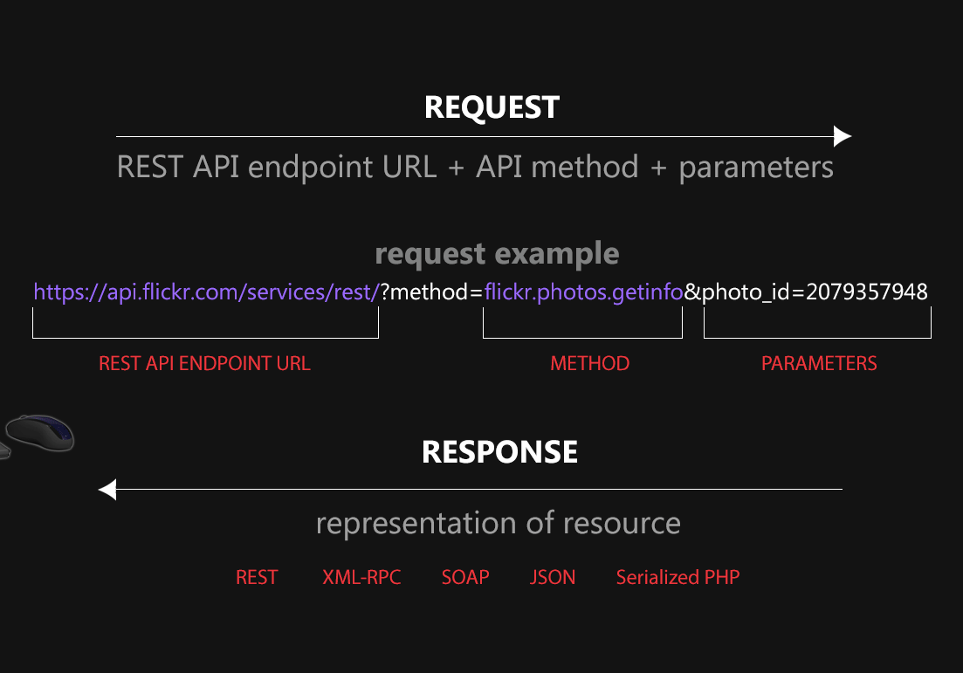
What’s a Web API?
A web API is an API that uses the internet to interface with computers
Specifically, this means a web API uses HTTP (hypertext transfer protocol) to communicate with computers
Web APIs use cleverly formatted URLs to communicate.

Slide 5
Step Back: What is HTTP?
HTTP is a specific type of protocol for designed for fetching text-based documents and designed with HTML in mind.
HTTP works through HTTP requests.
There are different types of HTTP requests, but the two most commonly used are:
Get requests
These get documents/data
Post requests
These submit/send data

Slide 6
Step Back: What is HTTP?
What happens when you use Google Chrome?
You type in a URL (which begins with “http://”)
You click “Enter”, which causes Chrome to make an HTTP Get request using that URL
That URL points to a computer somewhere with files on it.
Chrome returns the specific file(s) you requested back to you and formats it so it looks pretty
What happens when you use a web API?
Something very similar!

Slide 7
Difference Between the Web and a Web API
HTTP is designed to transfer HTML, which are documents meant to be read by humans
With some slight modifications, HTTP can be used to transfer data that is meant to be read by computers
Those “slight modifications” are changes to:
How data is requested (so changes to the URL)
And how data is received (JSON rather than HTML)

Slide 8
Why Should We Care?
“Web Scraping” is the process of turning HTML data into machine-readable or tabular data
Essentially, you have to undo all of the formatting intended for humans
Web APIs are designed for computers (not humans) and provide direct access to data
In many cases, there might be data that you can web scrape that is available via a web API!
Big Picture: Web APIs can provide direct access to the data you want

Slide 9
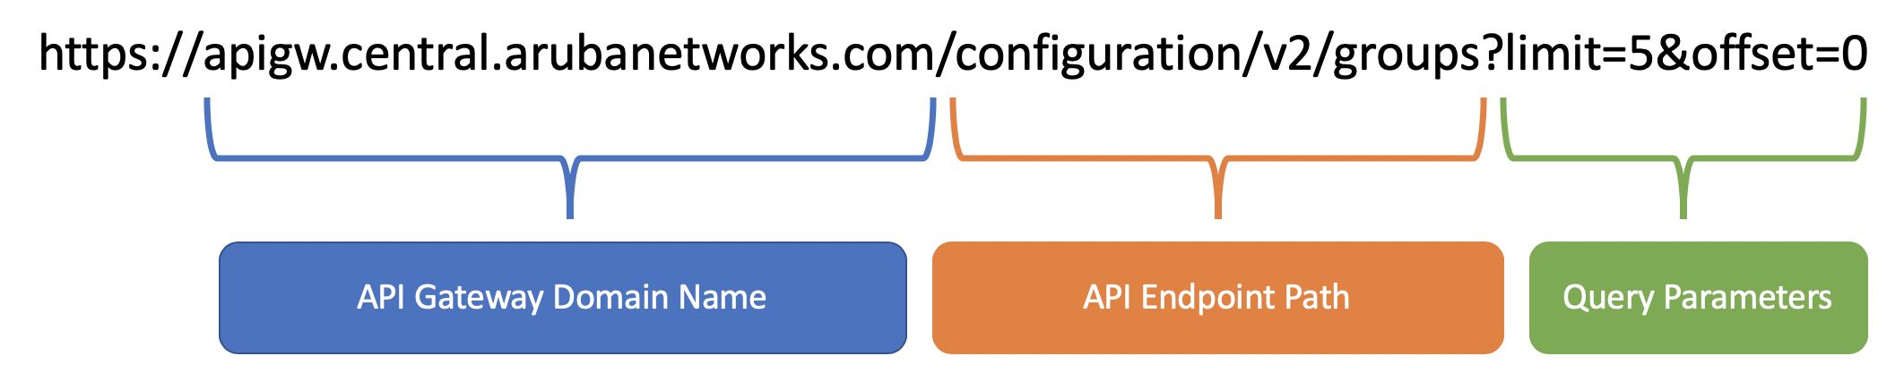
What’s in a Web API? – Parameters and Endpoints
The two primary components of a web API are the endpoint and the parameters
The endpoint and parameters combine to form the URL

Slide 10
What’s in a Web API? – Parameters and Endpoints
For a Get request, the endpoint defines the “function” and specifies the resources you are trying to “get”
The parameters can be thought as the arguments of the function and can do many things, like specify specific data within the endpoint
Parameters are separated from the endpoint by a “?” and separated from one another with the “&” symbol

Slide 11
The Response – Web APIs for the Web
What does a Web API return?
Depends on the API
Could return a single number, text data, an image, or even a whole webpage
Example: Google
Try typing in the following web API request into your browser: www.google.com/search?q=CRA
API Details:
Endpoint: www.google.com/search
Parameter q is set to CRA

Slide 12
The Response - Web APIs for Other Applications
There are publicly available web APIs for almost anything.
See this GitHub repo for a list of cool web APIs https://github.com/public-apis/public-apis
Use the link below to return a random image of a beagle
https://dog.ceo/api/breed/beagle/images/random
Does not require any parameters
The response is in JSON format
Does not return a webpage

Slide 13

What is JSON?
JSON Example: Response from dog.ceo API request
{"message":"https:\/\/images.dog.ceo\/breeds\/beagle\/n02088364_12710.jpg", "status":"success"}
JSON stands for JavaScript Object Notation
JSON is comprised of two types of data: arrays and objects (key-value pairs)
In the above example, we have an object with two key-values pairs

Slide 14
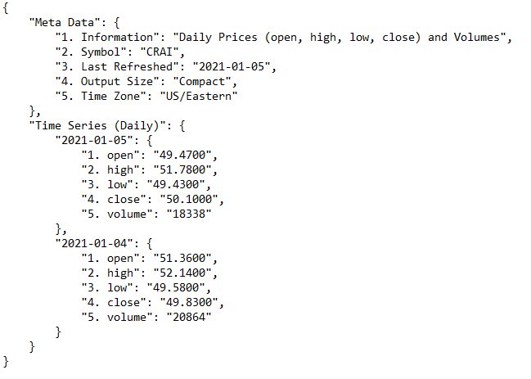
What is JSON?
Let’s look at a more complicated example from the AlphaVantage API
This JSON data shows CRA’s NASDAQ trading data for the first two days of 2021
The data is three-dimensional
The object associated with the name “2021-01-05” is in an object associated with the name “Time Series (Daily)”
The object associated with the name “Time Series Daily” is part of a larger JSON object.

Slide 15
API Addendum – Encoding and Authorization
Passing a string with spaces to a parameter in an API
Spaces are not allowed in URLs
Spaces, and other characters not allowed in URLs, must be encoded before sending an API request
Spaces are encoded as “%20”
Try: https://www.google.com/search?q=cra%20international
Some APIs require authorization in the form of an API key
API keys allow API owners to keep track of who is requesting what
For example, you can register for an API key for Alpha Vantage at this link https://www.alphavantage.co/support/#api-key
Then, the key is passed as a parameter in the request
e.g. https://www.alphavantage.co/query?...&apikey=YOUR_KEY

Slide 16
Let’s Try it Out!

